Slide 1
TED Talk Views Prediction
BY,
Bharath P

Slide 2
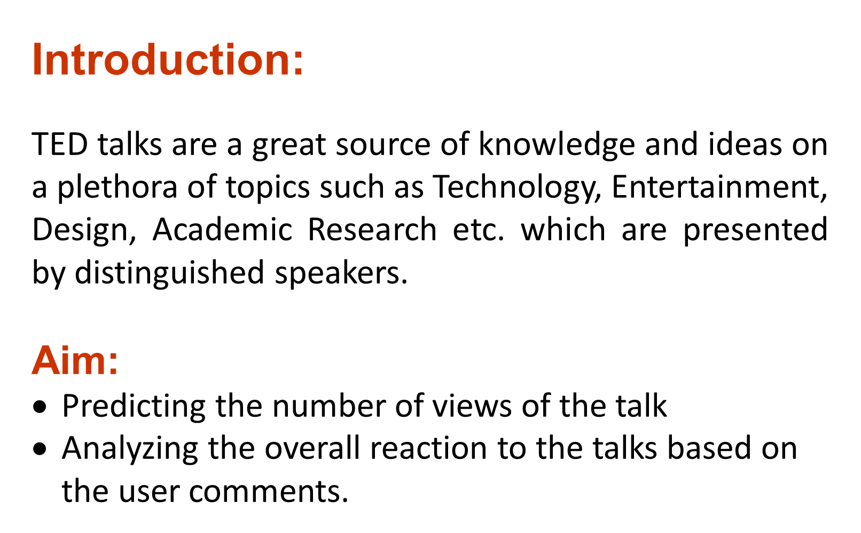

Slide 3
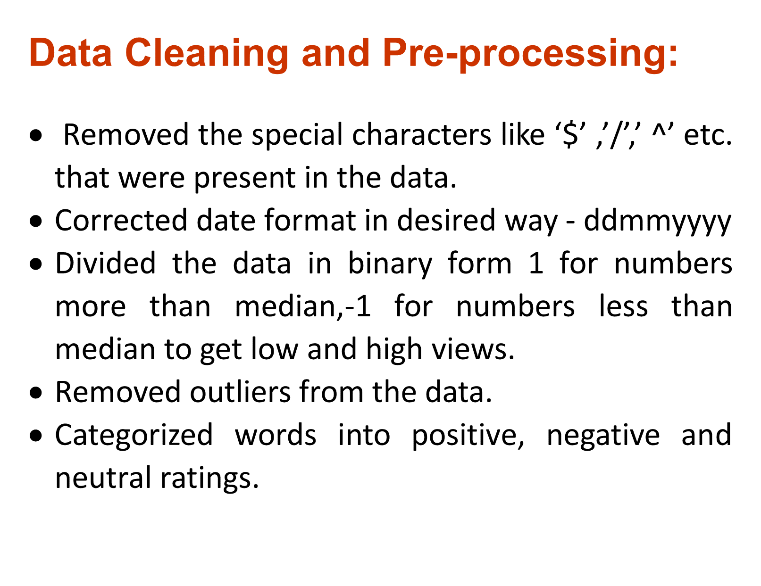

Slide 4
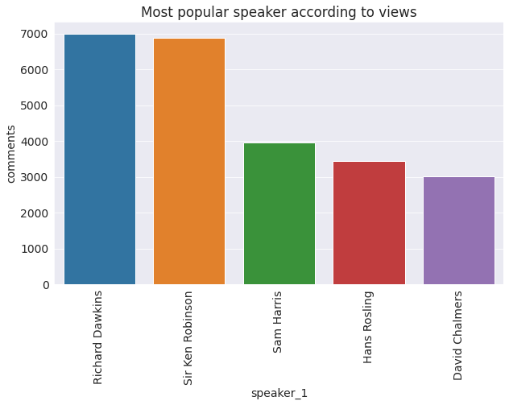
Visualization:

Slide 5
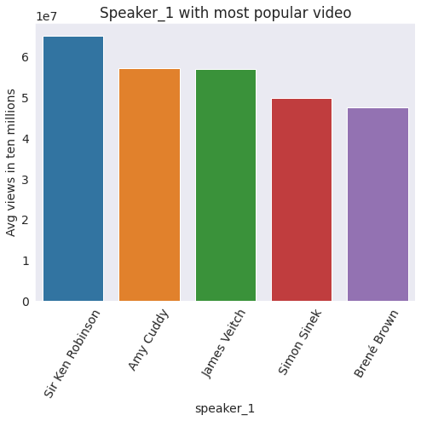

Slide 6
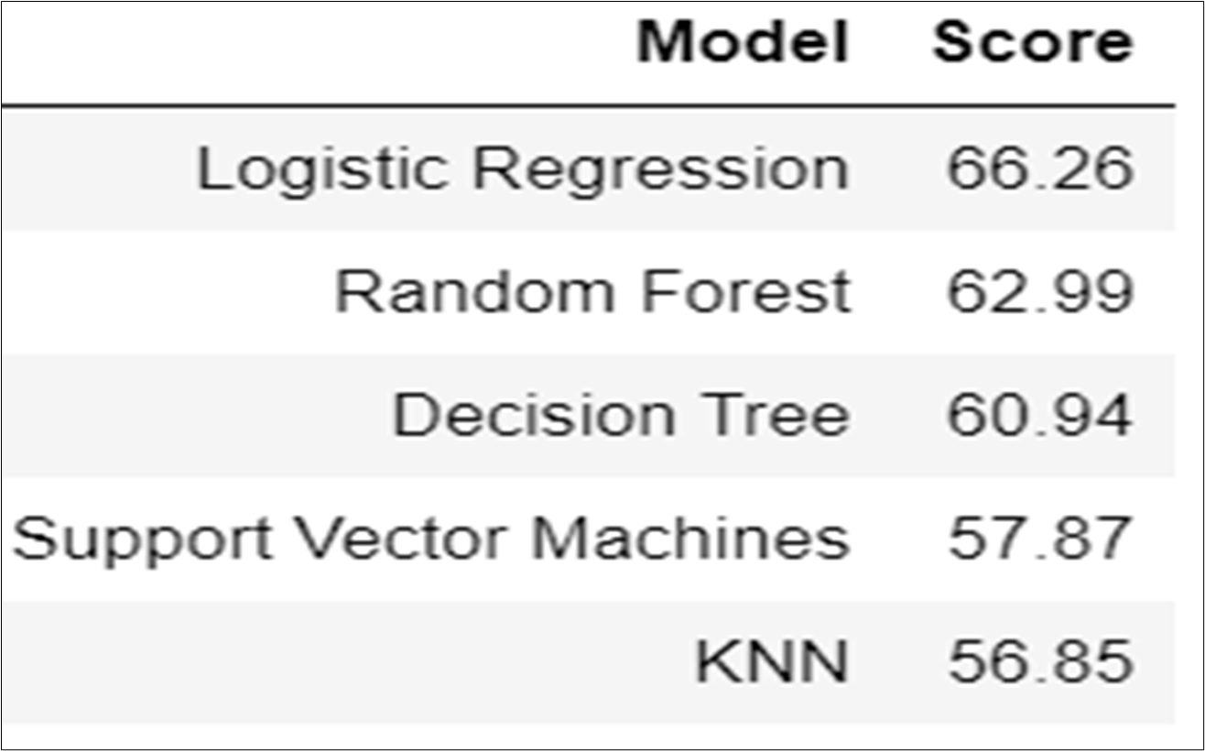
Accuracy percentage for predictions

Slide 7
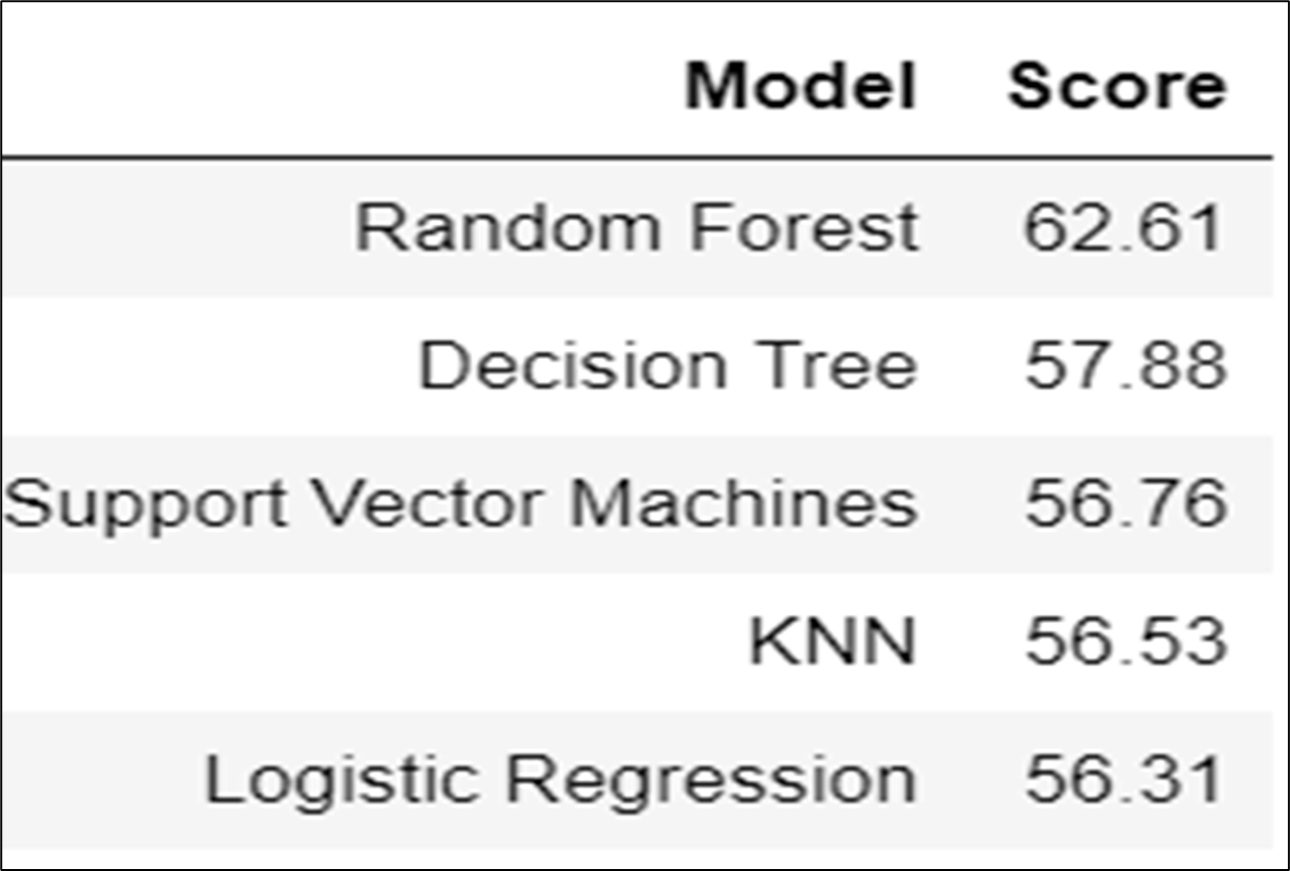

Slide 8
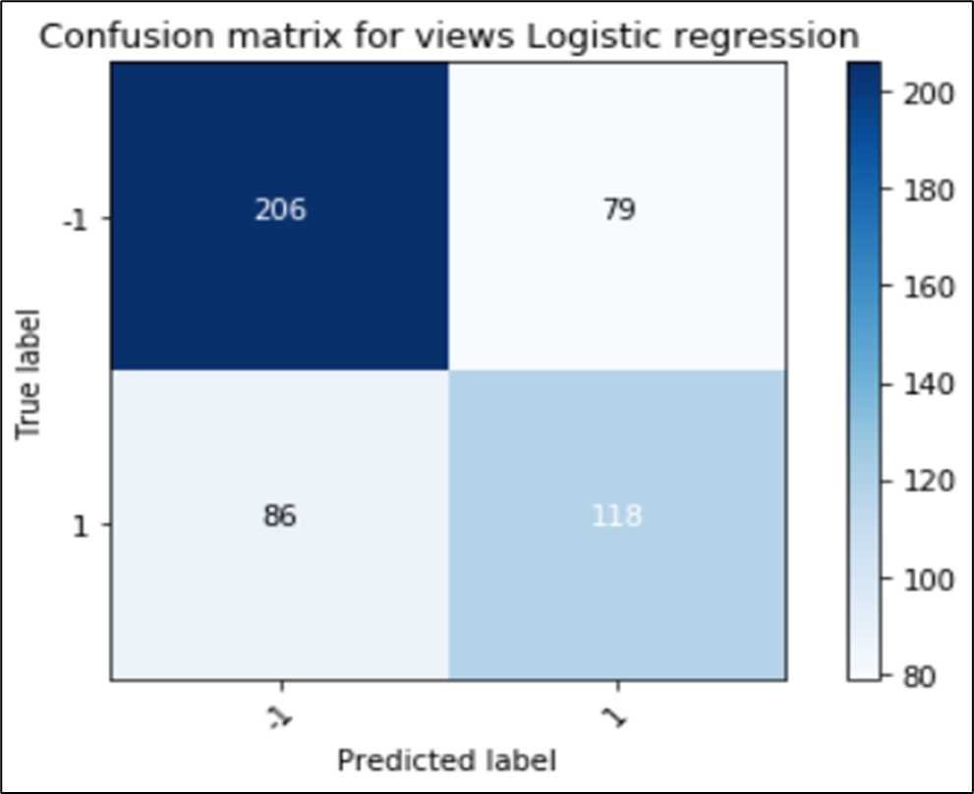
Confusion Matrix

Slide 9
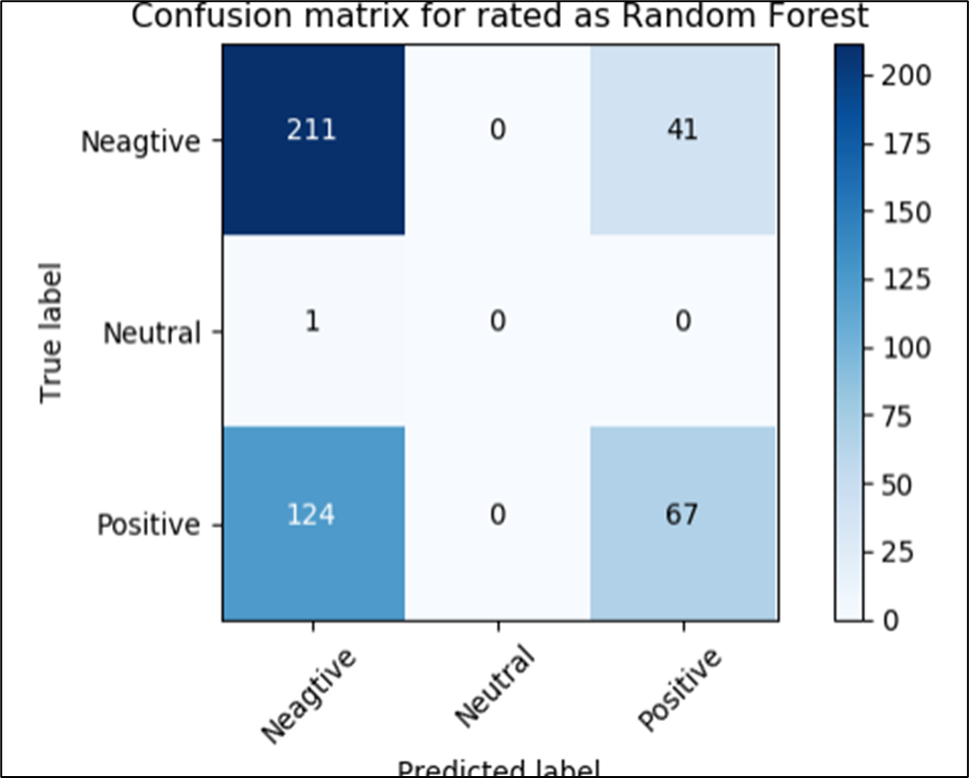

Slide 10


Slide 12
Thank you!!

